Slide 1
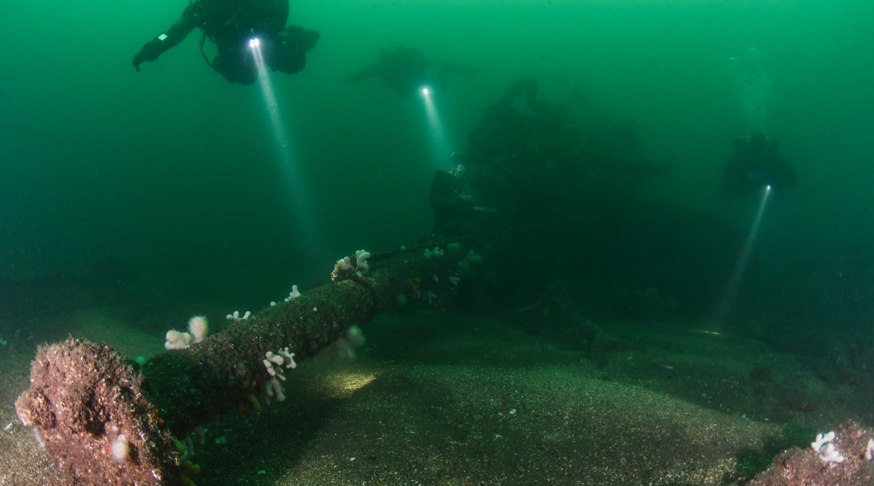
Berwickshire Ocean Observatory
Your portal to Berwickshire’s underwater world…
Notes:
Photo Credit – Marcus Rose
- Play ocean sounds when students arrive in class
- Introduce the ocean observatory, its an exciting online platform we are going to explore today to learn more about our ocean!

Slide 2
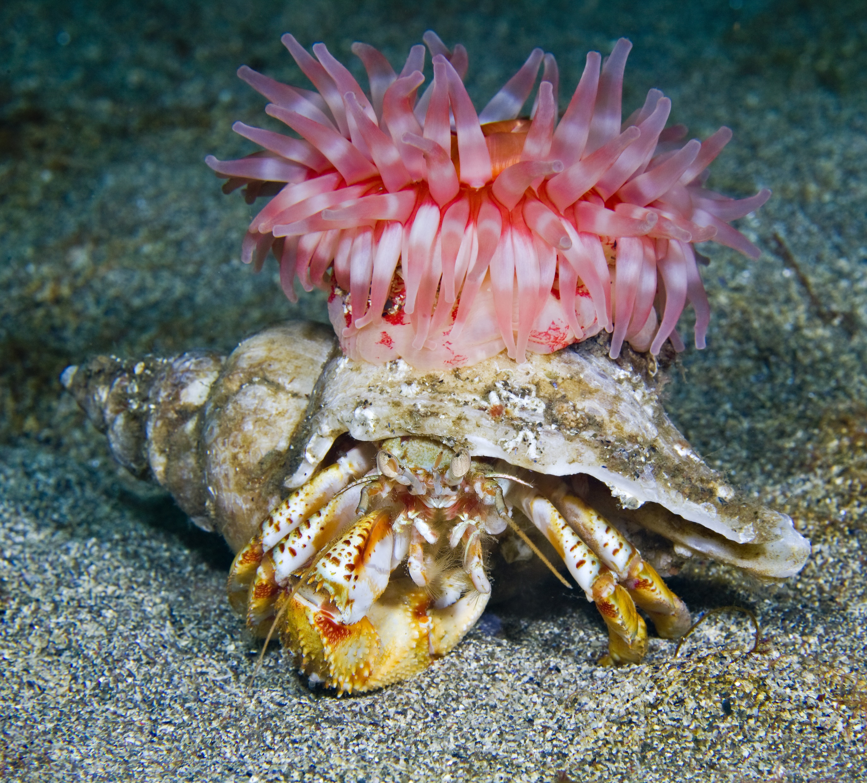
Learning Objectives
1.Understand why a healthy ocean is important
2. Make conclusions about the effectiveness of MPAs, using Berwickshire as an example
3. Communicate effectively about marine life to inspire others to care
4. Apply scientific observation and data collection techniques
Notes:
Credit – Jim Greenfield, OceanEye Photo
Explain the learning objectives to the class.
We will revisit this slide at the end of the lesson, here you will ask students reflect on and give evidence for each.

Slide 3
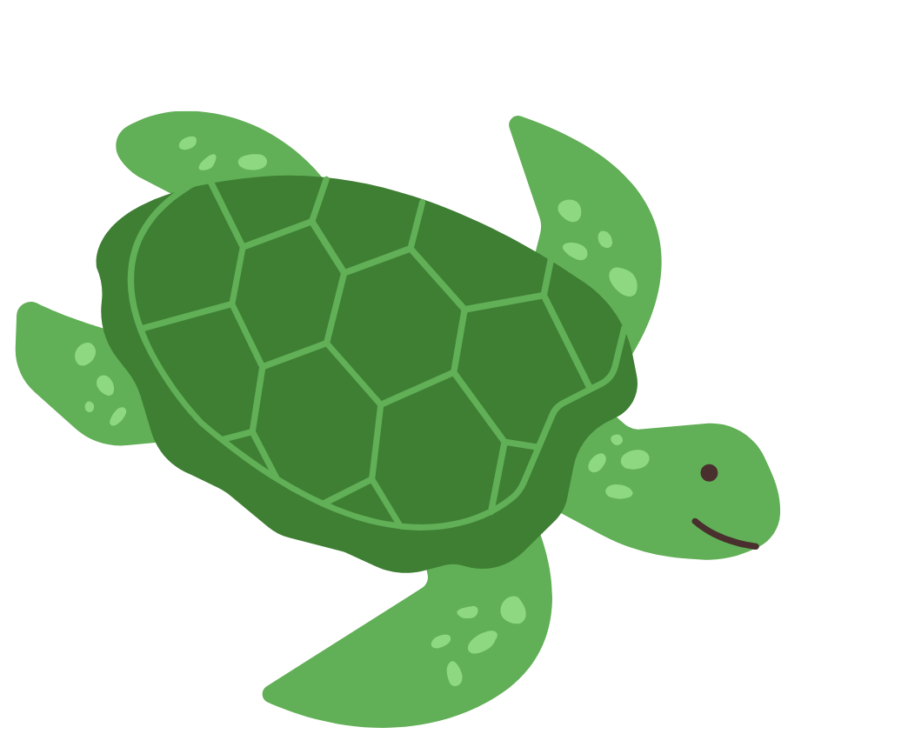
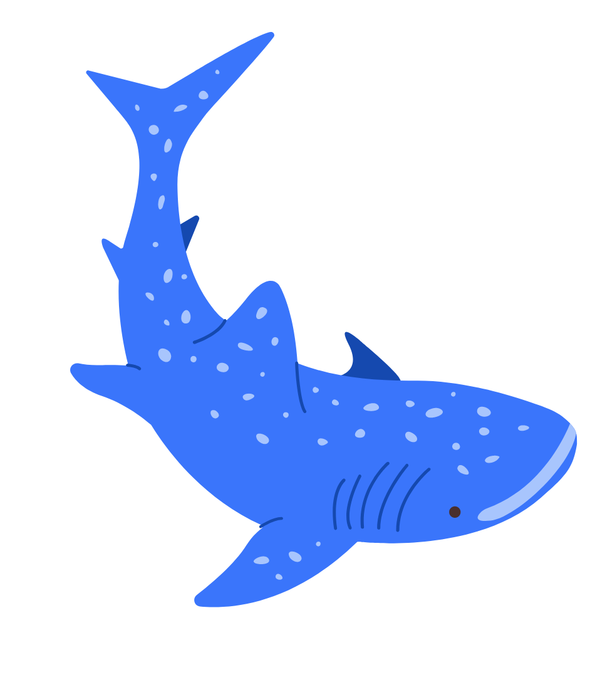
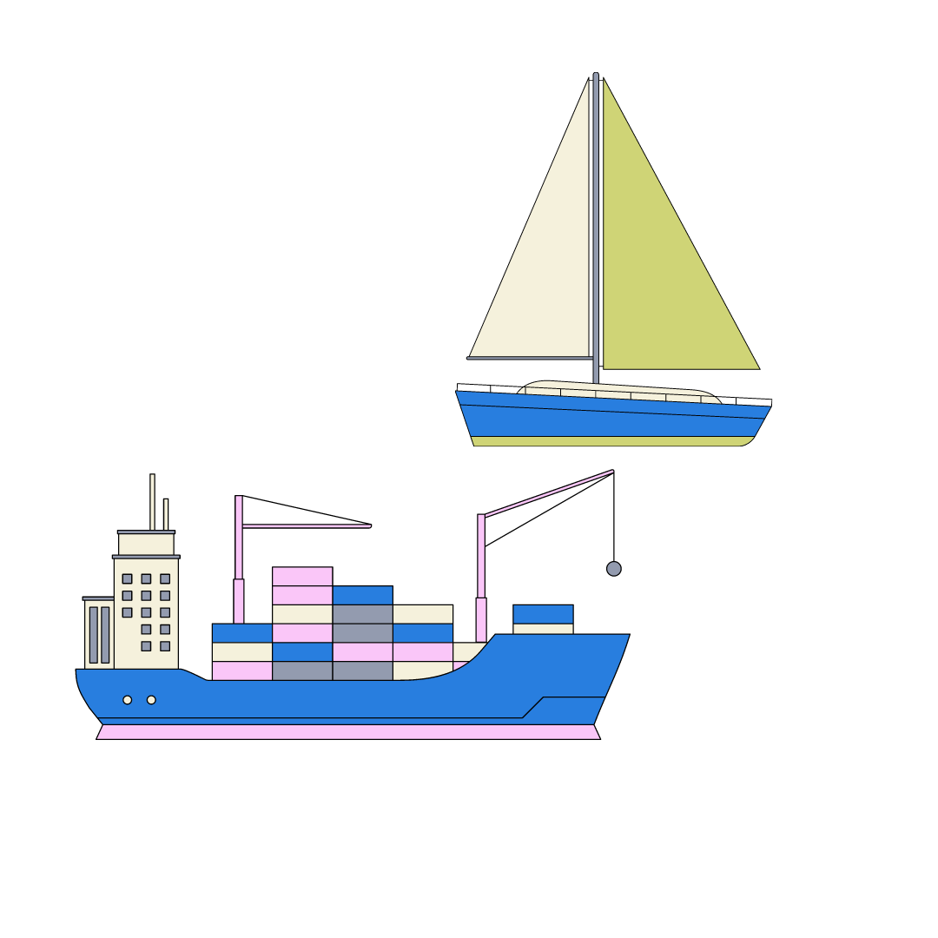
Why is a healthy ocean important?
Notes:
Ask student to brainstorm, using the images here as prompts
Here’s what I came up with!
Go through the icons and see if the class got these.
Ask if there are any questions on any of the things noted here.
Optional extra – visit this blog post OCEAN WEEK: What the ocean does for us - Blue Marine FoundationBlue Marine Foundation

Slide 4
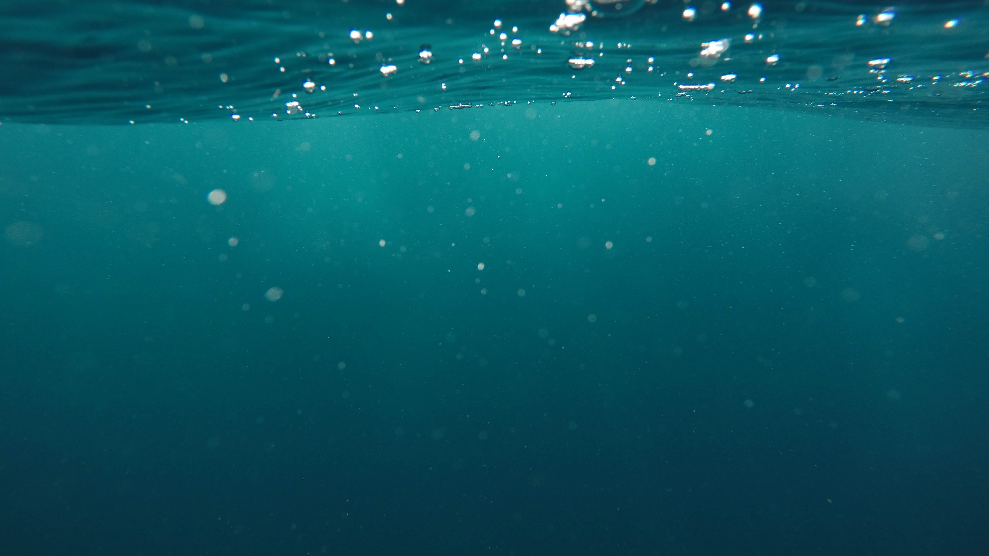
Transport
Tourism
Research
Biodiversity
Medicine
Energy
Jobs and economy
Food
Weather and climate
Oxygen
Water cycle
Carbon cycle
Natural resources
Coastal protection
Fun!

Slide 5
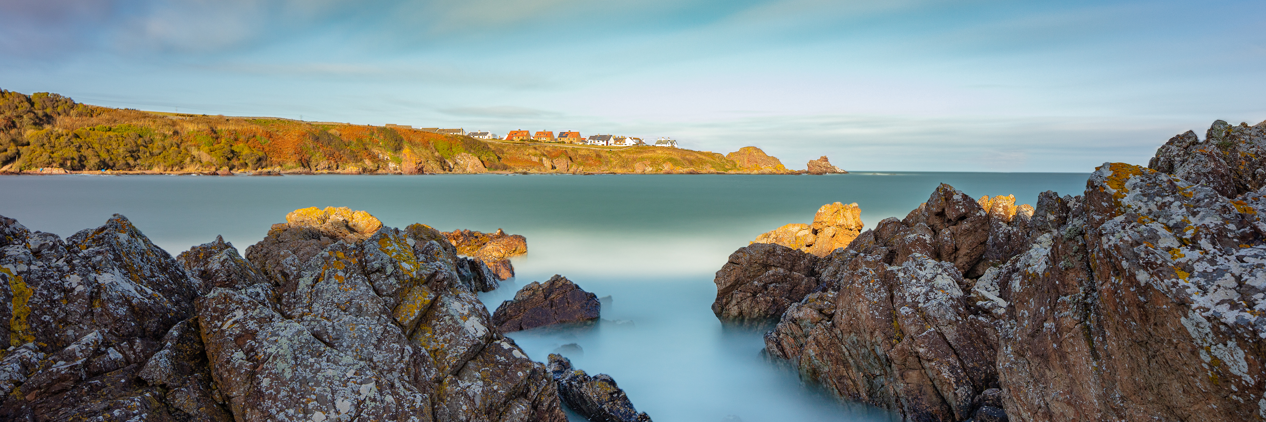
The Berwickshire MPA
What?
Why?
Who?
Where?
Notes:
Credit – Paul Richards
The Berwickshire Ocean Observatory takes a look underwater in the Berwickshire MPA. Before we dive under the waves and see this for ourselves, we are going to learn a little bit about MPAs. First of all – what is an MPA? What does it stand for?
Ask students to visit the following websites and answer the following questions:
Blue Marine’s website, Berwickshire page Berwickshire - Blue Marine FoundationBlue Marine Foundation
MPA Atlas Global Marine Protection | Marine Protection Atlas (mpatlas.org)
Kids article on MPAs Marine Protected Areas: A Way to Protect Our Oceans · Frontiers for Young Minds (frontiersin.org). Hint – you might not need to read the whole article!
All of the information you need to answer the questions is within these 3 websites. Give ~15/20 minutes to explore.

Slide 6
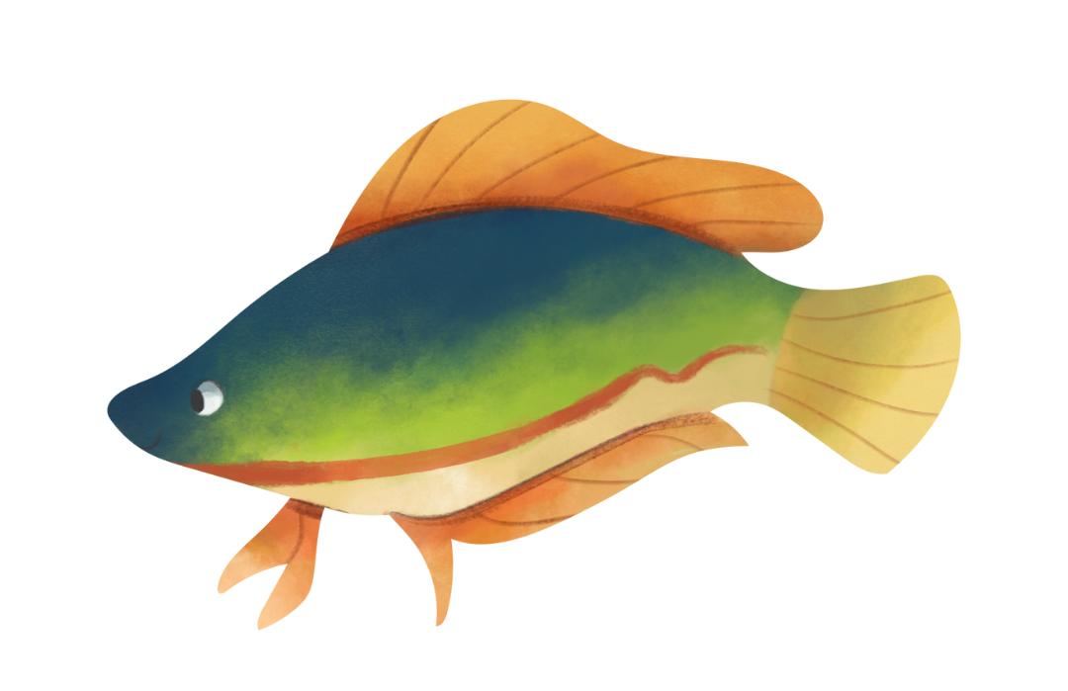
Answer these questions in pairs…
What does MPA stand for?
What is an MPA?
Where is the Berwickshire MPA located?
Where are other MPAs located around the world?
Why are MPAs needed?
Why should we protect Berwickshire specifically?
Who lives there? (marine life)
Who is working to protect Berwickshire’s coast?
Marine Protected Area
An area of ocean that protects important animals and habitats
East coast of Scotland
Everywhere – global distribution
Protecting biodiversity, fisheries, job and livelihoods, locking in carbon
Unique biodiversity from currents converging
e.g. Devonshire cup corals, bottlenose dolphins, Arctic wolffish
Blue Marine Foundation, responsible fishermen
Notes:
Remove question 4 and the MPA atlas activity for a shorter lesson
- After the time is up, go through some example answers to these questions, discuss any extra detail that students may have come up with

Slide 7
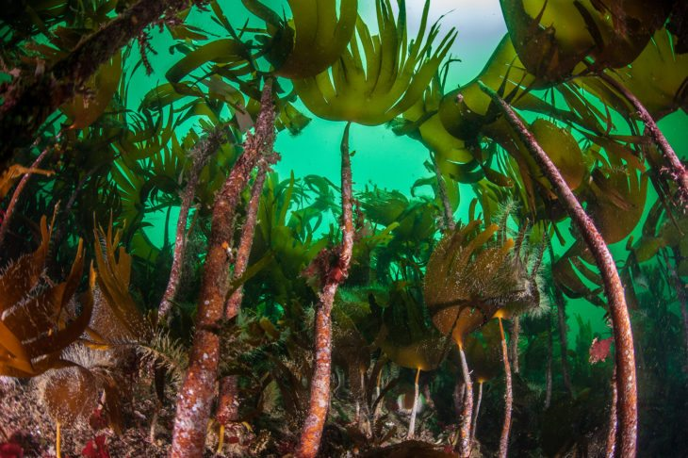
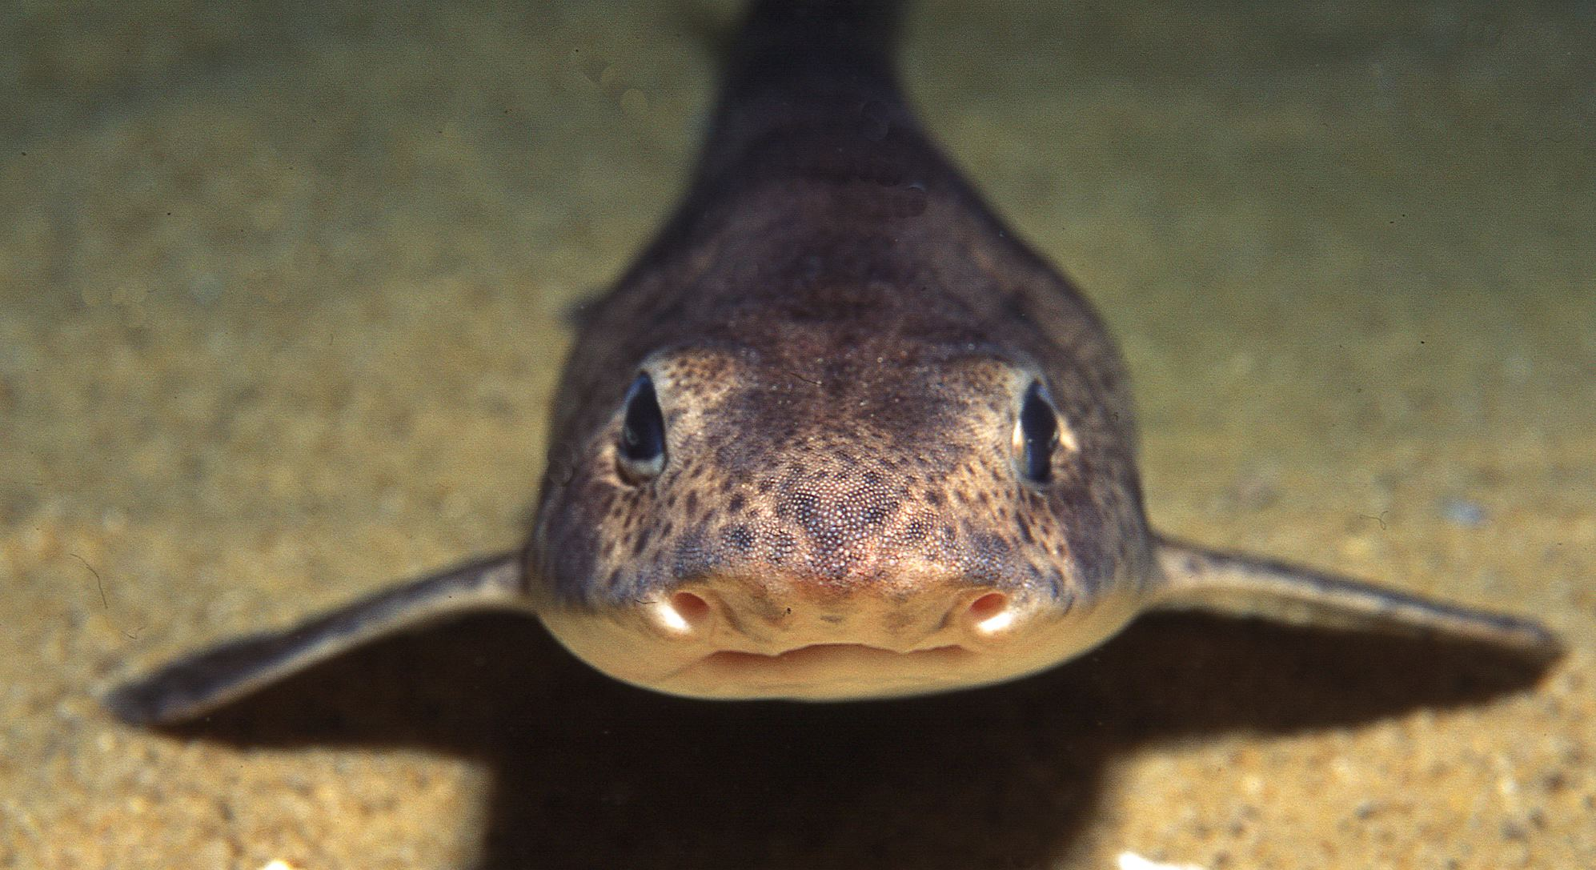
Activity 1 – The Observatory
Take some time to browse the archive of underwater footage!
Notes:
- Depending on time available in class, give either 5/10/15mins for free time browsing
- Ask students to take notes, or draw pictures of anything they think is particularly beautiful or interesting
- Ask students to share what they found with the class (to encourage storytelling and communication skills)

Slide 8
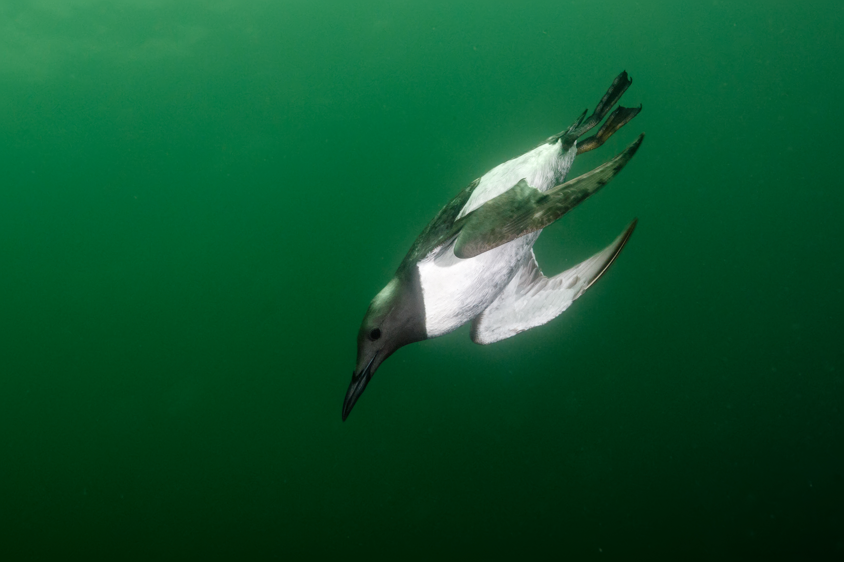
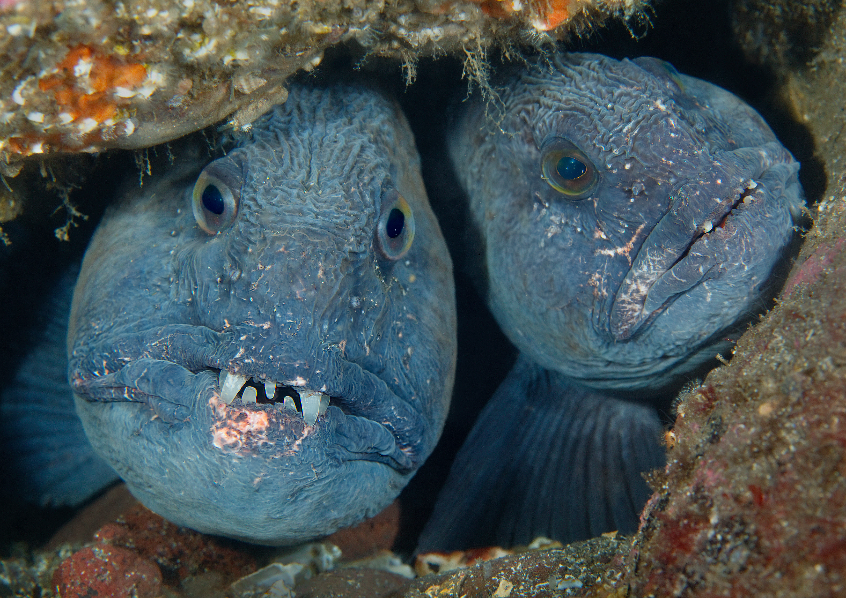
Activity 2 –
The Science Centre
Select a discovery pack, follow the instructions and complete the worksheet!
Notes:
- Ask students to select a discovery pack, follow the instructions and complete the worksheet!
- Give 20-30 mins to complete one discovery pack
- Ask students to share answers, peer mark and discuss

Slide 9
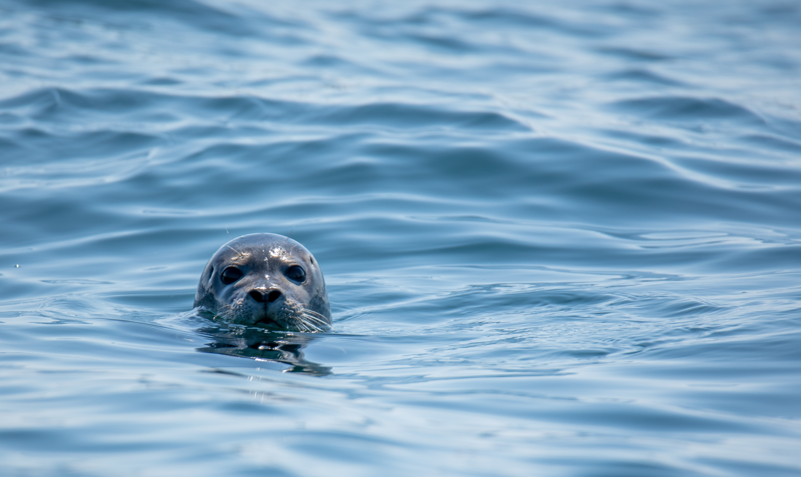
How can YOU make a positive difference to the ocean?
Notes:
- Ask students to write ‘ocean pledges’ on sticky notes and put them up on the whiteboard
- Discuss and share ideas among the class

Slide 10
Learning Objectives
1.Understand why a healthy ocean is important
2. Make conclusions about the effectiveness of MPAs, using Berwickshire as an example
3. Communicate effectively about marine life to inspire others to care
4. Apply scientific observation and data collection techniques
Notes:
Credit – Jim Greenfield, OceanEye Photo
Revisit the learning objectives. Do students feel more confident in each of these after this lesson?
Additional activities on MPAs
target_mpa_article.pdf (sciencejournalforkids.org)
These are the Ocean's Protected Areas—and We Need More | National Geographic – YouTube
Create a Marine Protected Area | National Geographic Society

